Slide 1
Final Project
<TEAM MEMBERS>

Slide 2
Slide 2: Contributions of each team member (1 slide)
Data set identification – Ahmad
Problem Definition – Ahmad / Chris
Data extraction – Ahmad/Chris
Data transformation – Chris
Data cleaning – Chris
Objective Function Formulation
Write the Objective Function (without regularization)
Objective Function Implementation
Next focus: Program the core gradient descent algorithm
Then: incorporate ridge regression penalty term
Then incorporate lasso regression penalty term
Objective function calibration (i.e., training) – Chris
Objective function testing (i.e., out-of-sample) – Chris
Discussions of results – Ahmad/Chris

Slide 3
3. Problem Description
Goal: (high-level, plain English description of the problem; why it is important?) (1 slide)
We want to be able to determine the most relevant drivers to determining blood glucose level, so that we may help future patients with diabetes understand what activities help keep blood sugar under control.

Slide 4
4. Optimization Model
Goal: objective function, constraints; explain the rationale behind your model) (1 slide)
Reason: This was because we will ultimately run a regularized Linear Regression algorithm, which is sensitive to outliers.
Goal: Least amount of features that allow us to cross an MSE below a certain threshold
Minimizing the number of features
Subject to:
-->
Glucose level

Slide 5
5. Proposed Solution
Goal: is it convex/non-convex?; what is the feasible set?; why did you conclude that a solution may exist; closed-form solution; numerical solution using a toolbox, etc.) (Max 5 slide)
We describe our objective function problem, constraints and feasible set based on the type of solution we expect.
Convex or non-convex problem: Convex
Feasible set: the code values (i.e., a discrete, integer set)
Does a solution exist? We expect a solution to exist as our regression problem will be attempting to fit a best line through our data with as few (parsimonious) variables as needed to maintain sufficient accuracy and generalizability to the test sample.
Numerical technique: The numerical technique will be a regularized objective function problem.

Slide 6
Validating Solution:
Prompt: How did you test your solution is valid, e.g., what dataset was used, simulation details, theoretical analysis, what problems you faced, how did you overcome them? etc. (max 5 slides)
Data Set Selection: We use the data set ‘Diabetes’ from the UC Irvine Machine Learning Repository. https://archive.ics.uci.edu/dataset/34/diabetes
Purpose of the dataset: The data was compiled in 1994 for the AI in Medicine Symposium (i.e., AAAI Spring Symposium on Interpreting Clinical Data). We credit Isaac Kohane, AIM-94 Co-Chair 8/27/1993 who provided a high-level business synopsis of the data set (i.e., jargon). In addition, we credit the author of the data set to Michael Kahn, MD, PhD, Washington University, St. Louis, MO) for the data we use for our course project. The data contains details on basic physiology and patho-physiology of diabetes mellitus and its treatment. The dataset is composed of 70 diabetes patient records collected from electronic and paper records. Patients are indexed by 1-70. Each patient has several weeks' to months' worth of outpatient care data.
How is the data organized? Data is organized per patient, with electronic records in time-stamp format vs. paper recordings in categorical format ((breakfast, lunch, dinner, bedtime).
What features do we have on every patient? Each patient has four features, each feature is separated by a tab and each patient is separated by a newline.
The data set consists of 4 features per patient.
Data-Codes (‘Code’): a listing of the codes used in the data sets.
Date in MM-DD-YYYY format: i.e., date of recording
Time in XX:YY format: i.e., time of recording
Value: i.e., blood glucose level
Because our data set is in “narrow” format and not in the traditional machine-learning ready format (“wide”) with one observation per row = 1 patient per 1 day and codes (events) not as individual columns, we need to conduct several processing transformations before we can split our data.
The initial challenges we encounter are:
Feature engineer an appropriate target variable: pivot → columns like 58–63
Handling missing values - filling missing with 0 – an N/A code on a particular day means no data available, rather than falsely imputing an event
averaging glucose values

Slide 7
Validating Solution:
Prompt: How did you test your solution is valid, e.g., what dataset was used, simulation details, theoretical analysis, what problems you faced, how did you overcome them? etc. (max 5 slides)
We describe how we transform our data set into narrow to wide format:
Maintaining temporal structure
We create a datetime combined index of Date + Time, which we will use to transform the data set for 1 patenti per 1 day
final_data['datetime'] = pd.to_datetime(final_data['Date'] + ' ' + final_data['Time'], errors='coerce')
final_data['day'] = final_data['datetime'].dt.date
Then we will unstack the ‘Code’ column to create the ‘wide’ data set’, rather than tall.
final_data = pd.pivot_table(final_data, index=['PATIENT_ID', 'datetime'], columns='Code', values='Value')
Handling missing values - filling missing with 0 – an N/A code on a particular day means no data available, rather than falsely imputing an event
final_data = final_data.fillna(final_data.mean())
Feature engineer an appropriate target variable: pivot → columns like 58–63
Per ChatGPT, raw code values are weak.
averaging glucose values
Averaging results in artificial smoothing of the events pre/during/post meals, which we’d want to capture
Addressing bad data:
Measurement date “06-31-1991” – not accurate, presumably let’s record at 6/30/1991, valid last day of June
final_data['datetime'].unique() #14741 unique observations

Slide 8
Validating Solution:
Prompt: How did you test your solution is valid, e.g., what dataset was used, simulation details, theoretical analysis, what problems you faced, how did you overcome them? etc. (max 5 slides)
How did we process the data? The data is stored as a zip compressed file. Therefore, we extract the data using Python into individual CSV files (one per patient), which we then combine into a single data set for downstream analysis. We unstack the ‘Code’ ciolumn to parse out each individual code as it’s own column. We include PATIENT_ID (1,…,70) and Date/Time as record index identifiers. We will index the data by date and patient ID.
We will need to address sparse nulls, i.e., for a patient, there is no recording at a specific time.
Exploratory stats: timeframe, # patients, total recordings per patient

Slide 9
Validating Solution:
Prompt: How did you test your solution is valid, e.g., what dataset was used, simulation details, theoretical analysis, what problems you faced, how did you overcome them? etc. (max 5 slides)
Next, we conducted any necessary pre-processing on the data i.e., check for nulls, check distribution of features for any outliers

Slide 10
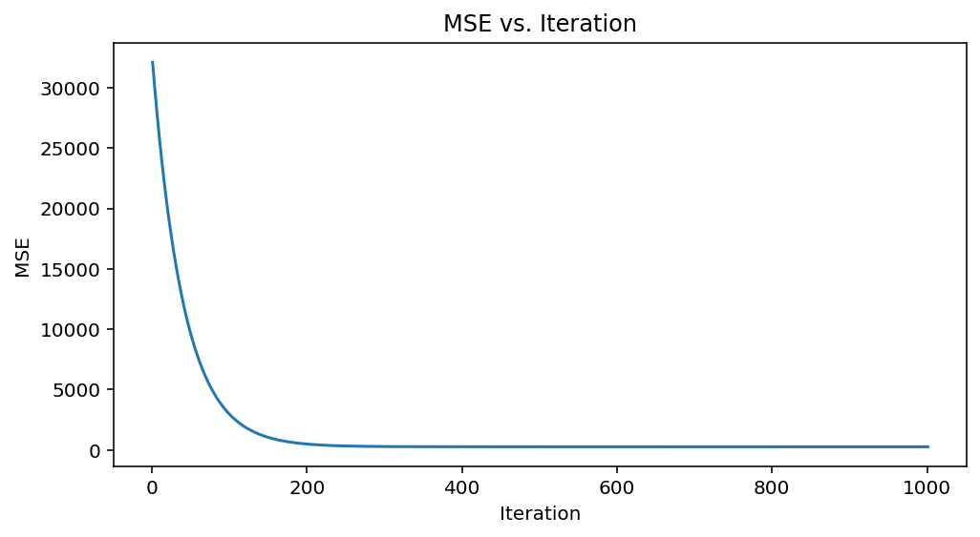
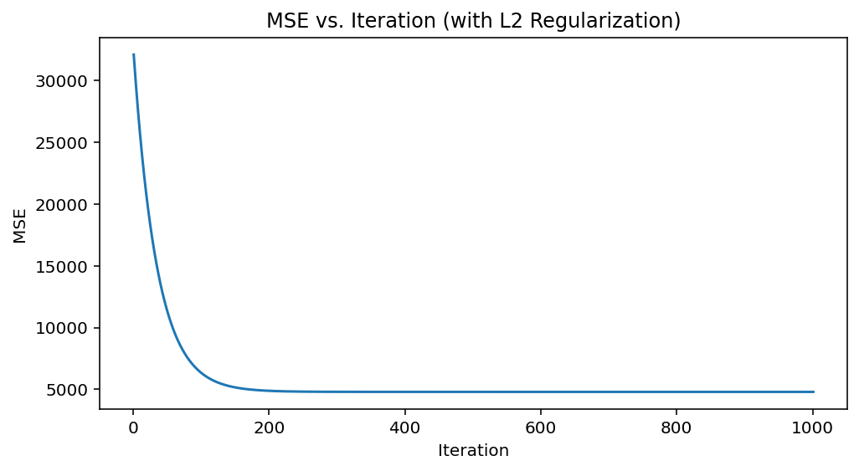
Validating Solution:
Prompt: How did you test your solution is valid, e.g., what dataset was used, simulation details, theoretical analysis, what problems you faced, how did you overcome them? etc. (max 5 slides)
We code our regression problem.
V1 plots (before we transformed our data into the actual proper form). We display our plots of MSE (cost function) against iteration number for both base and L2 regularization.

Slide 11
Validating Solution:
Prompt: How did you test your solution is valid, e.g., what dataset was used, simulation details, theoretical analysis, what problems you faced, how did you overcome them? etc. (max 5 slides)
Next, we conducted any necessary pre-processing on the data i.e., check for nulls, check distribution of features for any outliers
Reason: This was because we will ultimately run a regularized Linear Regression algorithm, which is sensitive to outliers.
We prepare our data for training
To conduct our training, we use stratified sampling across patient, and a time-based ordered split to preserve temporal order in the data.
Next, we define our target variable as the ‘Level of blood glucose measurement’.
Given that in the data set, we have multiple measurement columns, our first challenge is to determine what we should use as the target level which would be representative of the patient given their specific glucose indicators.
48 = Unspecified blood glucose measurement
57 = Unspecified blood glucose measurement
58 = Pre-breakfast blood glucose measurement
59 = Post-breakfast blood glucose measurement
60 = Pre-lunch blood glucose measurement
61 = Post-lunch blood glucose measurement
62 = Pre-supper blood glucose measurement
63 = Post-supper blood glucose measurement
64 = Pre-snack blood glucose measurement
Solution: Let’s average the measurements per patient, per day and this is how we will predict (i.e., daily periodicity).
We now need to define our target variable
predict the number the optimal number of codes such that they minimize glucose levels

Slide 12
Validating Solution:
Prompt: How did you test your solution is valid, e.g., what dataset was used, simulation details, theoretical analysis, what problems you faced, how did you overcome them? etc. (max 5 slides)
Next we split the data into training and testing sets (80%, 20% split), which is typical as seen in industry.
We train our regularized linear regression model on the training data, where we calibrate the objective function as a penalty MSE (MSE + L2-norm penalty).
We obtain ideal coefficients
Testing testing 1-2 three
We obtain ideal coefficients from our optimization which we then define as our final model and we compute the training error given by MSC
next we compute out of sample accuracy on the test data held out the 20% and compute testing MSE

Slide 13
7. Key Insights
Goal: What does your solution mean for the problem? What are the key observations you made from the solutions as applied to the problem? (max 3 slides)
Our solution identifies the most relevant features (codes) to determining the blood glucose level.
We need to compute the accuracy of our model:
We split the data into training and testing
We just need to run the testing predctions
Ahmad – look at using PCA to identifying them most relevant codes to blood glucose level.

Slide 14
8. Major Conclusions
Goal: was your approach viable? Did you run into any difficulties such as infeasibility, numerical instability, unexpected results, etc. (2 slide)
xxx

Slide 15
9. Suggestions for Improvement and Future Work
Goal: if you had more time and resources what would you have done to solve the problem? e.g., considered a more realistic model, used a larger dataset, implemented a working prototype, launched a startup and become a billionaire! (1 slide)
xxx

Slide 16
Data Sourcing
DATASETS:
You are responsible for finding a dataset to use for your project. Places where you can look for data include: Kaggle competitions, Reddit forums have discussions on these topics.
Some helpful info:
https://www.kaggle.com/datasets?tags=15002-Optimization
https://openreview.net/pdf?id=PghuCwnjF6y
https://gray.mgh.harvard.edu/research/optimization/227-cort

Slide 17
Overview of the data (per the domain description file):
Patients with IDDM are insulin deficient. This can either be due to a) low or absent production of insulin by the beta islet cells of the pancreas subsequent to an auto-immune attack or b) insulin-resistance, typically associated with older age and obesity, which leads to a relative insulin-deficiency even though the insulin levels might be normal. Regardless of cause, the lack of adequate insulin effect has multiple metabolic effects. However, once a patient is diagnosed and is receiving regularly scheduled exogenous (externally administered) insulin, the principal metabolic effect of concern is the potential for hyperglycemia (high blood glucose). Chronic hyperglycemia over a period of several years puts a patient at risk for several kinds of micro and macrovascular problems (e.g. retinopathy). Consequently, the goal of therapy for IDDM is to bring the average blood glucose as close to the normal range as possible. As explained below, current therapy makes this goal a very challenging (and often frustrating) one for most patients. One important consideration is that due to the inevitable variation of blood glucose (BG) around the mean, a lower mean will result in a higher frequency of unpleasant and sometimes dangerous low BG levels.
Outpatient management. Outpatient management of IDDM relies principally on three interventions: diet, excercise and exogenous insulin. Proper treatment requires careful consideration of all three interventions. This is basically our target variable, measured by seeking to bring glucose levels to within normal range (e.g., mean).
INSULIN One of insulin's principal effects is to increase the uptake of glucose in many of the tissues (e.g. in adipose/fat tissue) and thereby reduce the concentration glucose in blood. Patients with IDDM administer insulin to themselves by subcutaneous injection. Insulin doses are given one or more times a day, typically before meals and sometimes also at bedtime. Many insulin regimens are devised to have the peak insulin action coincide with the peak rise in BG during meals. In order to achieve this, a combination of several preparations of insulin may be administered. Each insulin formulation has its own characteristic time of onset of effect (O), time of peak action (P) and effective duration (D). These times can be significantly affected by many factors such as the site of injection (e.g. much more rapid absorption in the abdomen than in the thigh) or whether the insulin is a human insulin or an animal extract. The times I have listed below are rough approximations and I am sure that I could find an endocrinologist with different estimates.
Regular Insulin: O 15-45 minutes P 1-3 hours D 4-6 hours
NPH Insulin: O 1-3 hours P 4-6 hours D: 10-14 hours
Ultralente: O: 2-5 hours. P (not much of a peak) D 24-30 hours.
EXERCISE Exercise appears to have multiple effects on BG control. Two important effects are: increased caloric expenditure and a possibly independent increase in the sensitivity of tissues to insulin action. BG can fall during exercise but also quite a few hours afterwards. For instance, strenuous exercise in the mid-afternoon can be associated with low BG after dinner. Also, too strenuous exercise with associated mild dehydration can lead to a transient increase in BG.
DIET. Another vast subject but (suffice it to say for the purposes of users of the data set) in brief: a larger meal will lead to a longer and possibly higher elevation of blood glucose. The actual effect depends on a host of variables, notably the kind of food ingested. For instance, fat causes delayed emptying of the stomach and therefore a slower rise in BG than a starchy meal without fat. Missing a meal or eating a meal of smaller than usual size will put the patient at risk for low BG in the hours that follow the meal.
GLUCOSE CONCENTRATIONS. BG concentration will vary even in individuals with normal pancreatic hormonal function. A normal pre-meal BG ranges approximately 80-120 mg/dl. A normal post-meal BG ranges 80-140 mg/dl. The target range for an individual with diabetes mellitus is very controversial. I will cut the Gordian knot on this issue by noting that it would be very desirable to keep 90% of all BG measurements < 200 mg/dl and that the average BG should be 150 mg/dl or less. Note that it takes a lot of work, attention and (painful) BG checks to reach this target range. Conversely, an average BG > 200 (over several years) is associated with a poor long-term outcome. That is, the risk of vascular complications of the high BG is signicantly elevated.
Hypoglycemic (low BG) symptoms fall into two classes. Between 40-80 mg/dl, the patient feels the effect off the adrenal hormone epinephrine as the BG regulation systems attempt to reverse the low BG. These so-called adrenergic symptoms (headache, abdominal pain, sweating) are useful, if unpleasant, cues to the patient that their BG is falling dangerously. Below 40 mg/dl, the patient's brain is inadequately supplied with glucose and the symptoms become those of poor brain function (neuroglycopenic symptoms). These include: lethargy, weakness, disorientation, seizures and passing out.

Slide 18
Python libraries
Stage: Validation and Data
Data set: https://archive.ics.uci.edu/dataset/34/diabetes
Data compression: https://pypi.org/project/ncompress/
Tarfile library: https://docs.python.org/3/library/tarfile.html
Unlzw3 (not used):
https://anaconda.org/channels/conda-forge/packages/unlzw3/overview
https://pypi.org/project/unlzw3/

